Slide 1

TrafficSense: Urban Traffic Flow Analytics & Congestion Prediction
PBADT504 Big Data Analytics Project
Presented By-
Abhijeet Rameshkumar Nair (CEC24AD005)
Ananthukrishna CU (CEC24AD014)
Abhinav KP (LCEC24AD058)
Amarnath A (LCEC24AD061)
Department of Artificial Intelligence & Data Science · Semester 5
College of Engineering, Cherthala

Slide 2

PROBLEM STATEMENT
Problem Statement & Motivation
Rapid urbanisation has intensified traffic congestion, travel delays, fuel wastage, and environmental damage. Traditional monitoring systems cannot process large-scale traffic data in real time — creating an urgent need for a scalable Big Data Analytics framework for intelligent transportation management.
Increasing Traffic Volume
Urban vehicle density grows year-on-year
Peak-Hour Congestion
Severe bottlenecks during rush hours
Inefficient Management
Legacy systems lack scalability
No Predictive Insights
Proactive congestion forecasting is absent

Slide 3
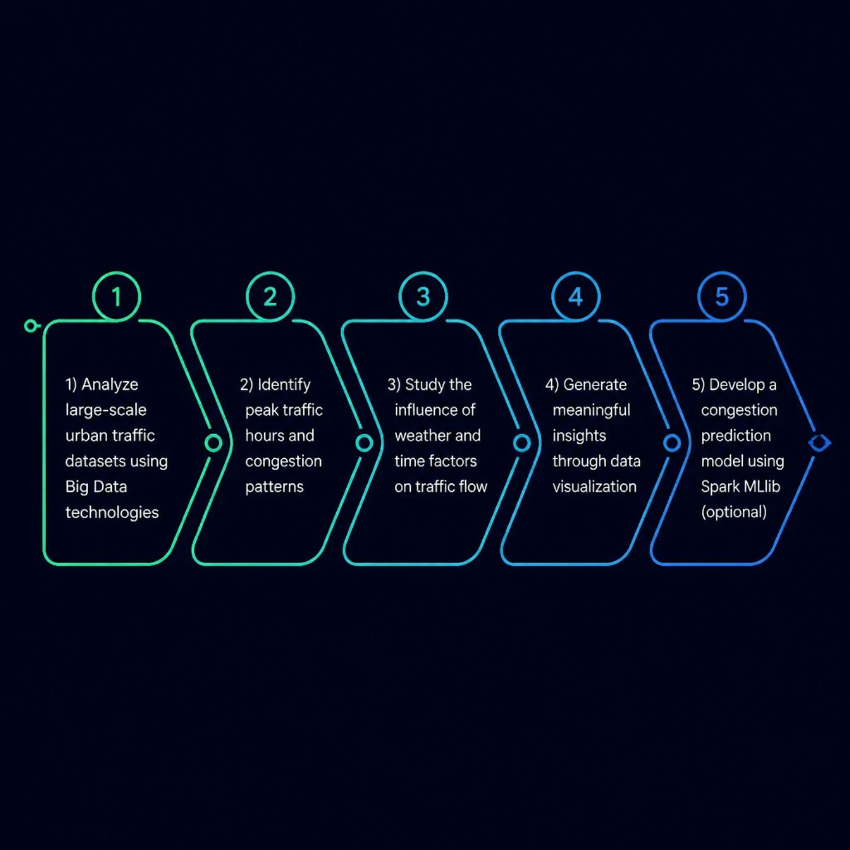
GOALS & DELIVERABLES
Objectives & Expected Outcomes
Expected Outcomes
Traffic Trend Analysis — Temporal and spatial congestion patterns
Congestion Identification — Peak-hour hotspot mapping
Interactive Dashboard — Power BI visual reports
Data-Driven Insights — Evidence-based traffic management
Predictive Model — MLlib congestion classification (optional)

Slide 4
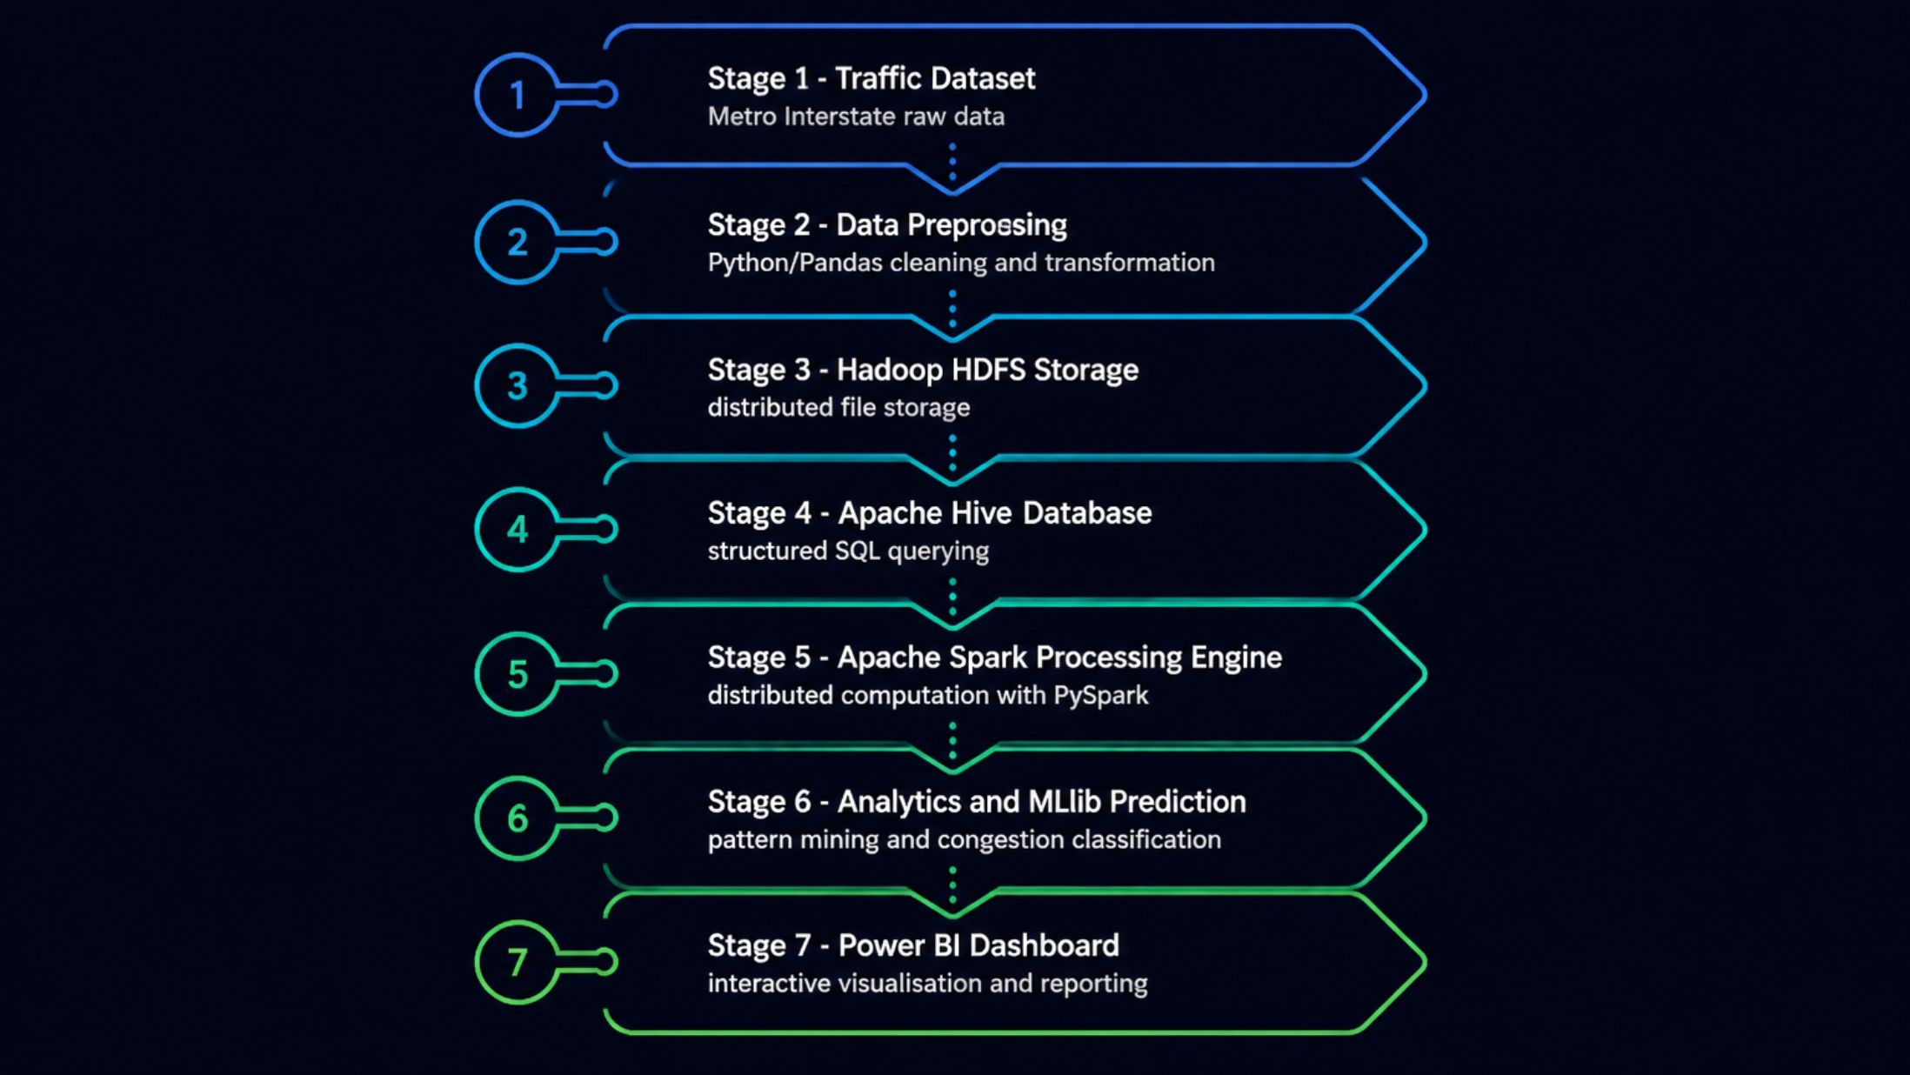
SYSTEM DESIGN
Proposed Big Data Architecture
An end-to-end pipeline integrating Hadoop HDFS, Apache Hive, Apache Spark, and Power BI for scalable urban traffic analytics and intelligent congestion prediction.
The pipeline flows from raw data ingestion through distributed storage (HDFS), structured querying (Hive), large-scale processing (Spark), machine learning (MLlib), and finally to interactive
Visualisation (Power BI) for actionable traffic insights.
Hadoop HDFS
Apache Hive
Apache Spark
PySpark
Spark MLlib
Power BI

Slide 5
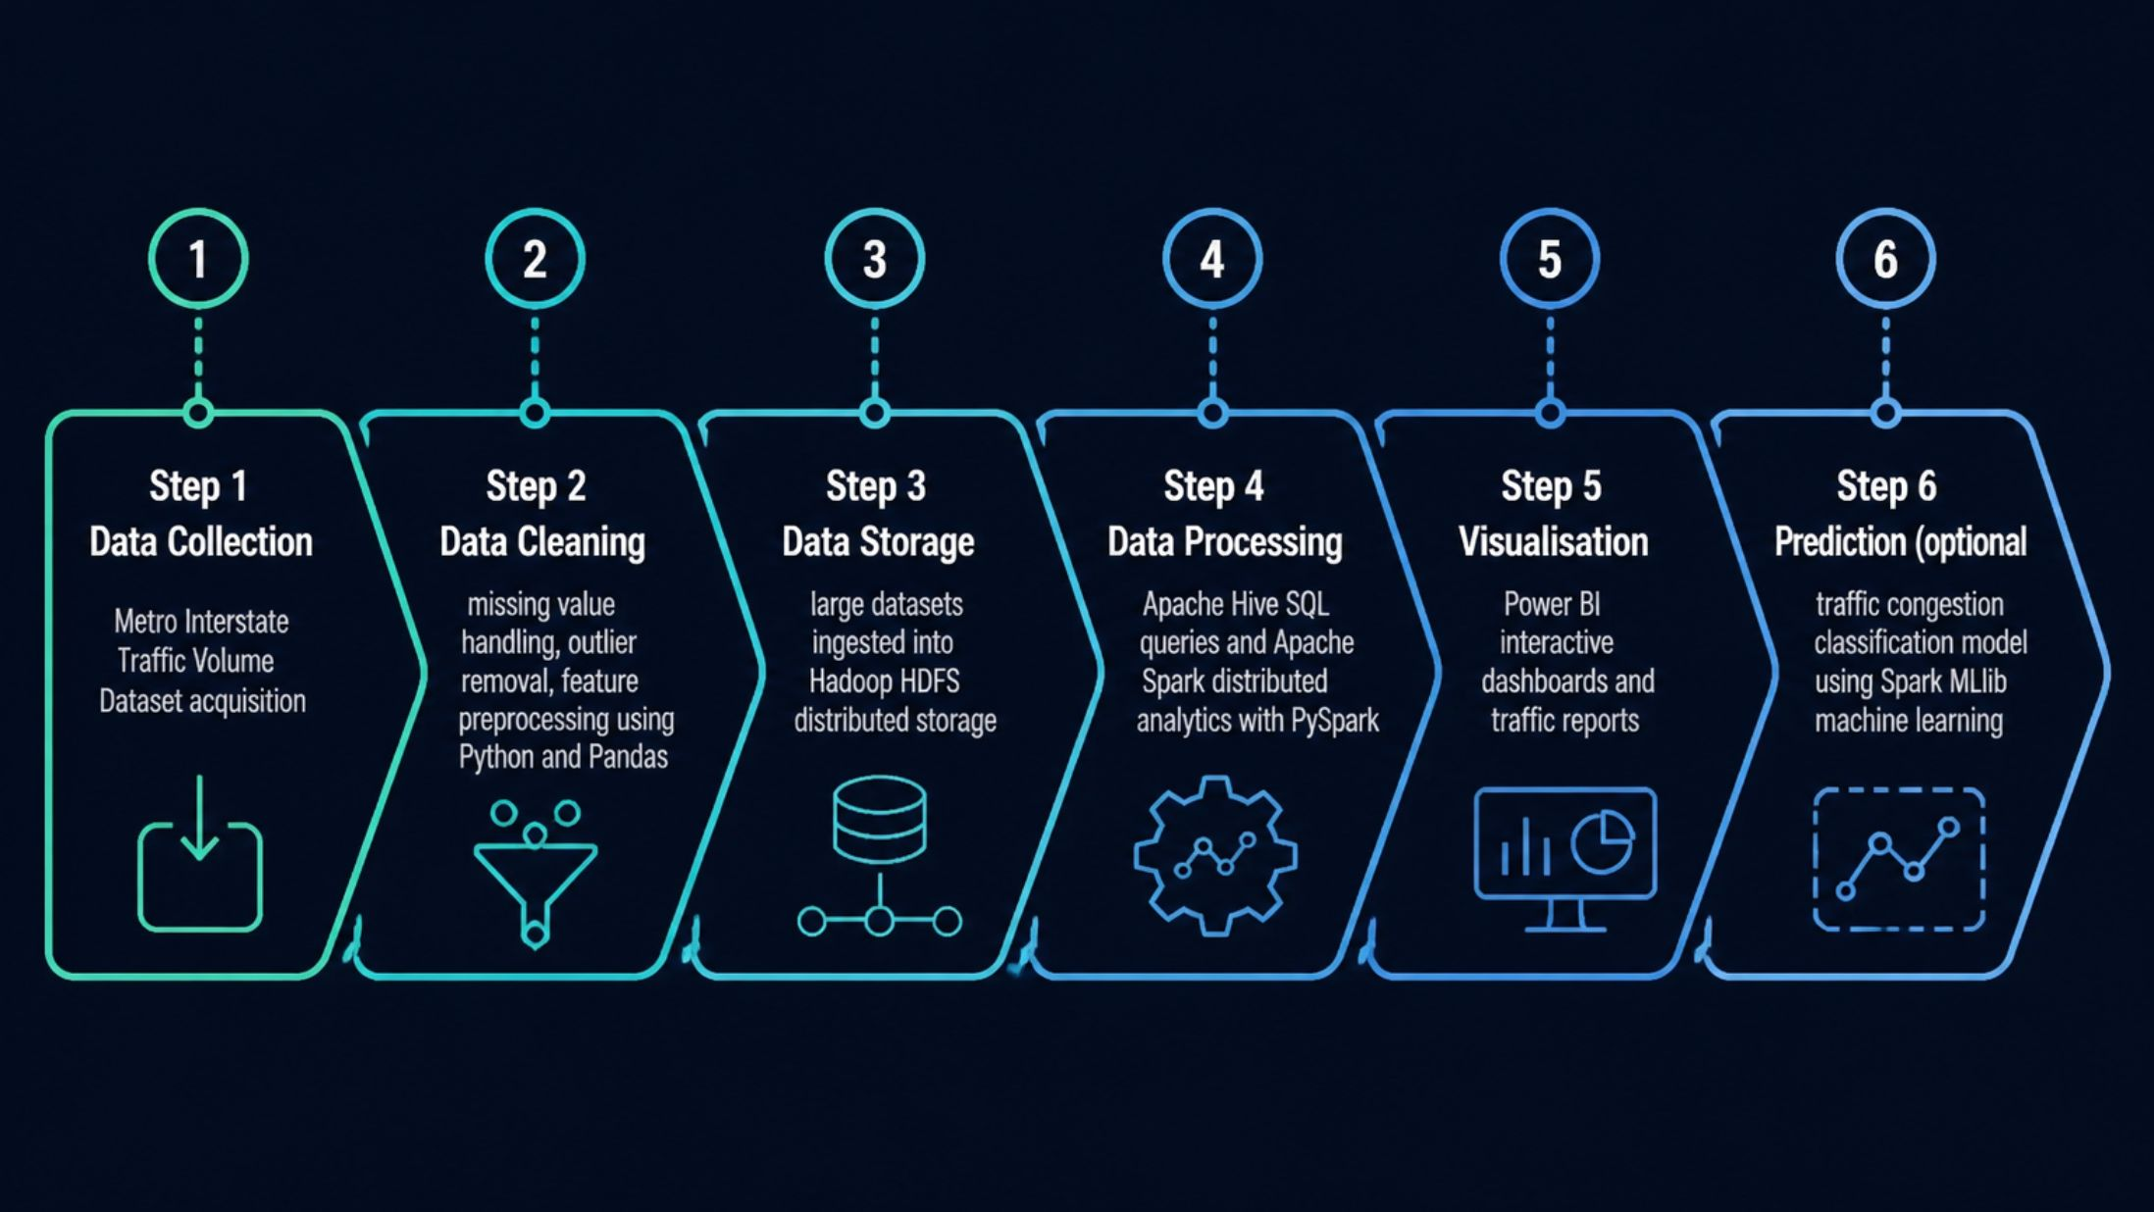
WORKFLOW
Methodology & Data Processing Pipeline
Each stage builds on the previous — from raw data collection through cleaning, distributed storage, parallel processing, visualisation, and optional ML-based congestion prediction —
ensuring a robust and reproducible analytics workflow.
📥 Data Collection
🧹 Data Cleaning
🗄️ HDFS Storage
⚡ Spark Analytics
Metro Interstate Dataset
Python & Pandas
Distributed storage
Hive queries + PySpark
📊 Visualisation
🤖 ML Prediction
Power BI dashboards
Spark MLlib (optional)

Slide 6
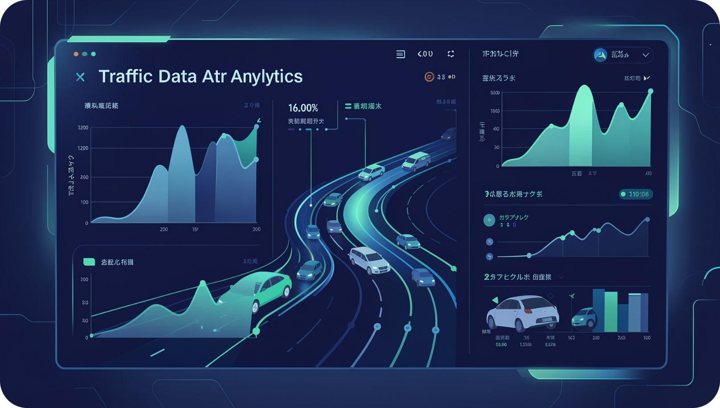
DATA SOURCE
Dataset Analysis & Project Feasibility
Metro Interstate Traffic Volume Dataset
48,000+ Records
Hourly traffic measurements (2012–2018)
Rich Feature Set
Date/time, volume, temperature, rainfall, snowfall, weather, holidays
Publicly Available
Kaggle — compatible with Hadoop & Spark
Semester-Ready
Completable within one academic semester

Slide 7
EXECUTION PLAN
Project Timeline & Milestones
A structured 12-week roadmap ensuring systematic progress from dataset acquisition to final submission.
Weeks 1–2
Topic finalisation, literature review & dataset collection
Weeks 3–4
Data preprocessing, EDA & feature engineering
Weeks 5–6
HDFS setup, data ingestion & Hive table creation
Weeks 7–8
Apache Spark analytics & PySpark query development
Week 9
Spark MLlib prediction module development
Week 10
Power BI dashboard design & integration
Week 11
Testing, validation & documentation
Week 12
Final presentation preparation & submission

Slide 8

Thank You
TrafficSense — Urban Traffic Flow Analytics & Congestion Prediction
Big Data Analytics Project Proposal · Semester 5 · AI & Data Science
Abhijeet Rameshkumar Nair
(CEC24AD005)
Ananthukrishna CU
(CEC24AD014)
Abhinav KP
(LCEC24AD058)
Amarnath A
(LCEC24AD061)
College of Engineering, Cherthala

